Slide 1


Modeling Rocket Trajectories
David Ordaz Perez Timothy Takahashi, PhD 2022 Statewide Symposium
April 23, 2022

Slide 2
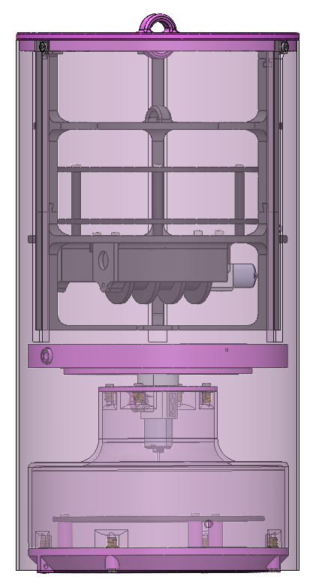
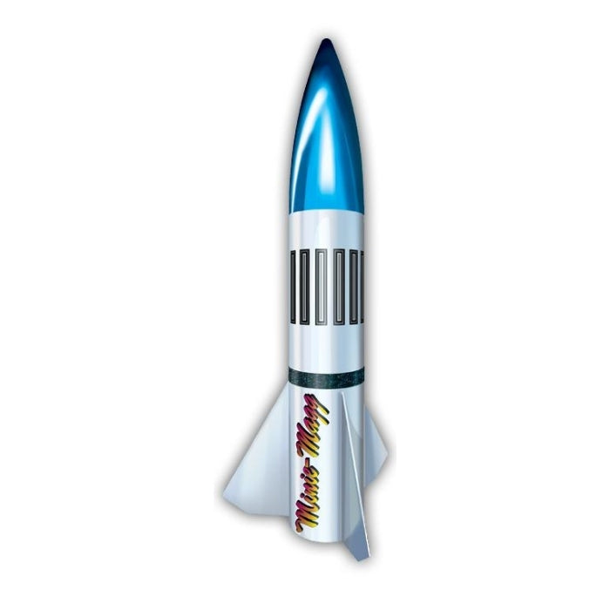
Mission Statement
Assisting in the Tethered Payload Mission
Objectives
Focused on creating a flight path model for the Recovery Team
Calculate Descent Rate and Landing Location
Source: Loc Precision
Full Configuration
MINI-MAGG 5.5”

Slide 3
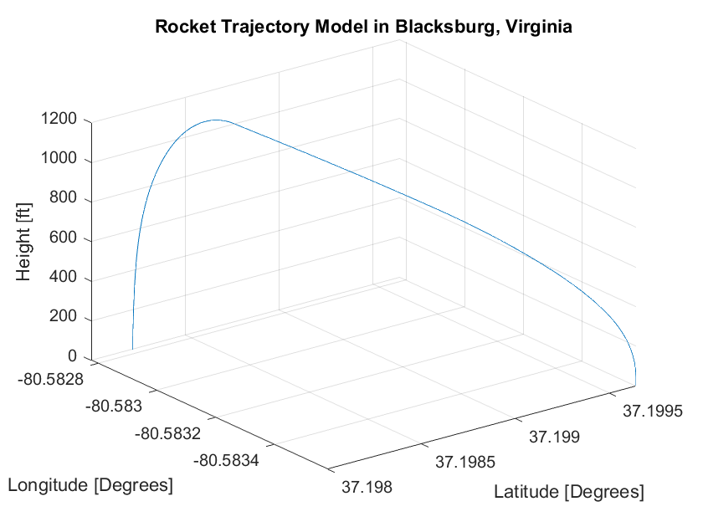
Methodology
Numerical Computations
Assumed: Incompressible, Steady, and Subsonic Flow
Vertical Flight Path
Horizontal Flight Path
Flight Path
+
=
Vertical Calculation: Derived Kinematic Equations for Numerical Differentiation
Horizontal Calculation: Numerically Interpolated Weather Data to Calculate Longitudinal and Latitudinal Displacements

Slide 4
Results and Interpretation
Drag Variation
Recovery Zone
Recovery Zone with Drag Variation
Descent Rate: 24.809 ft/s
Provides Recovery Team a Dispersion Model
Accuracy Tested at Competition

Slide 5
Acknowledgements
Special Thank You To:
Timothy Takahashi
ASU/NASA Space Grant
University of Wyoming

